Slide 1

Special Data for Special Needs
AI facilitating special need communities finding the right plan
Rico Martinez and Jon Sullins

Slide 2

Need for More support within our Special needs communities
Hard to find Information
Different coverage for Different needs
Availability

Slide 3




Set Up
Data Model- Unity Catalog
Custom Functions- Using SQL & Function Registry
AI Agent Model- ML flow a/b testing & deploying
Serving platform- Databricks apps and Unity catalog for governance

Slide 4
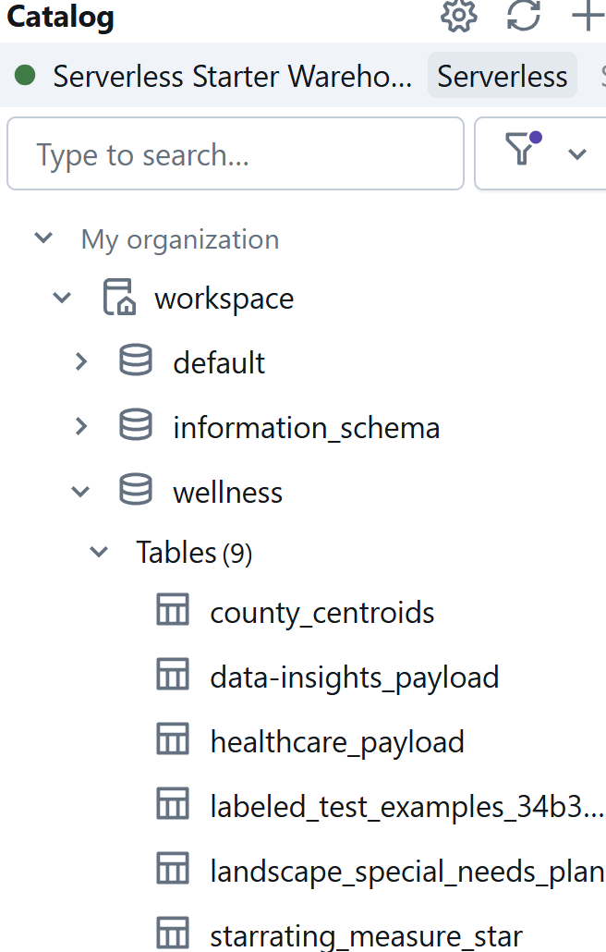
Data Model
Extract-Special_needs_data
Enrich with Geospatial Data
Contract_ID – Primary key
Explore Dataset

Slide 5
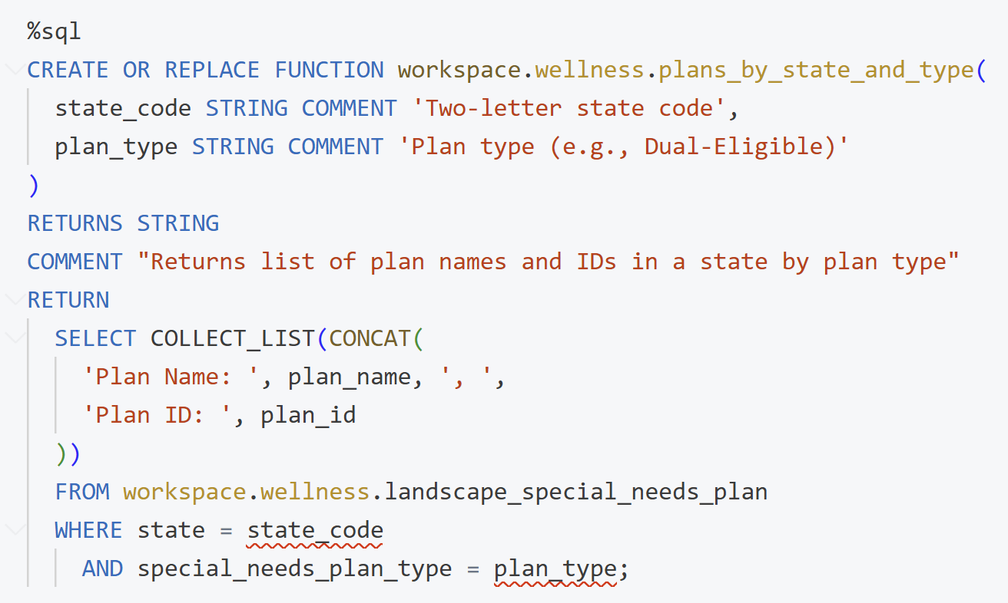
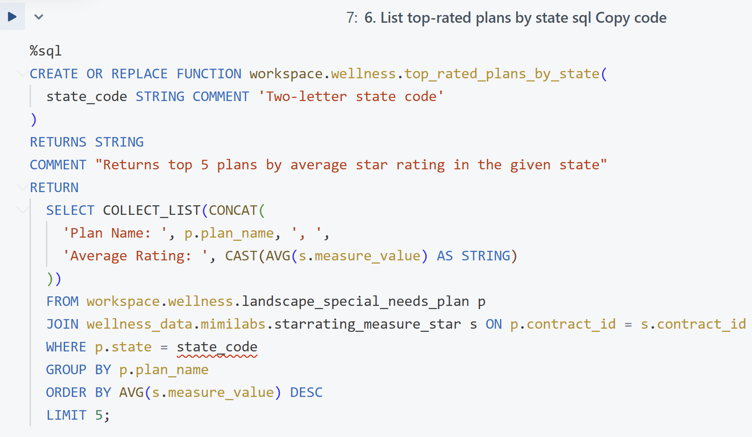
Custom functions
Custom Functions
Wellness Information
Out-Of-Box Experiment

Slide 6
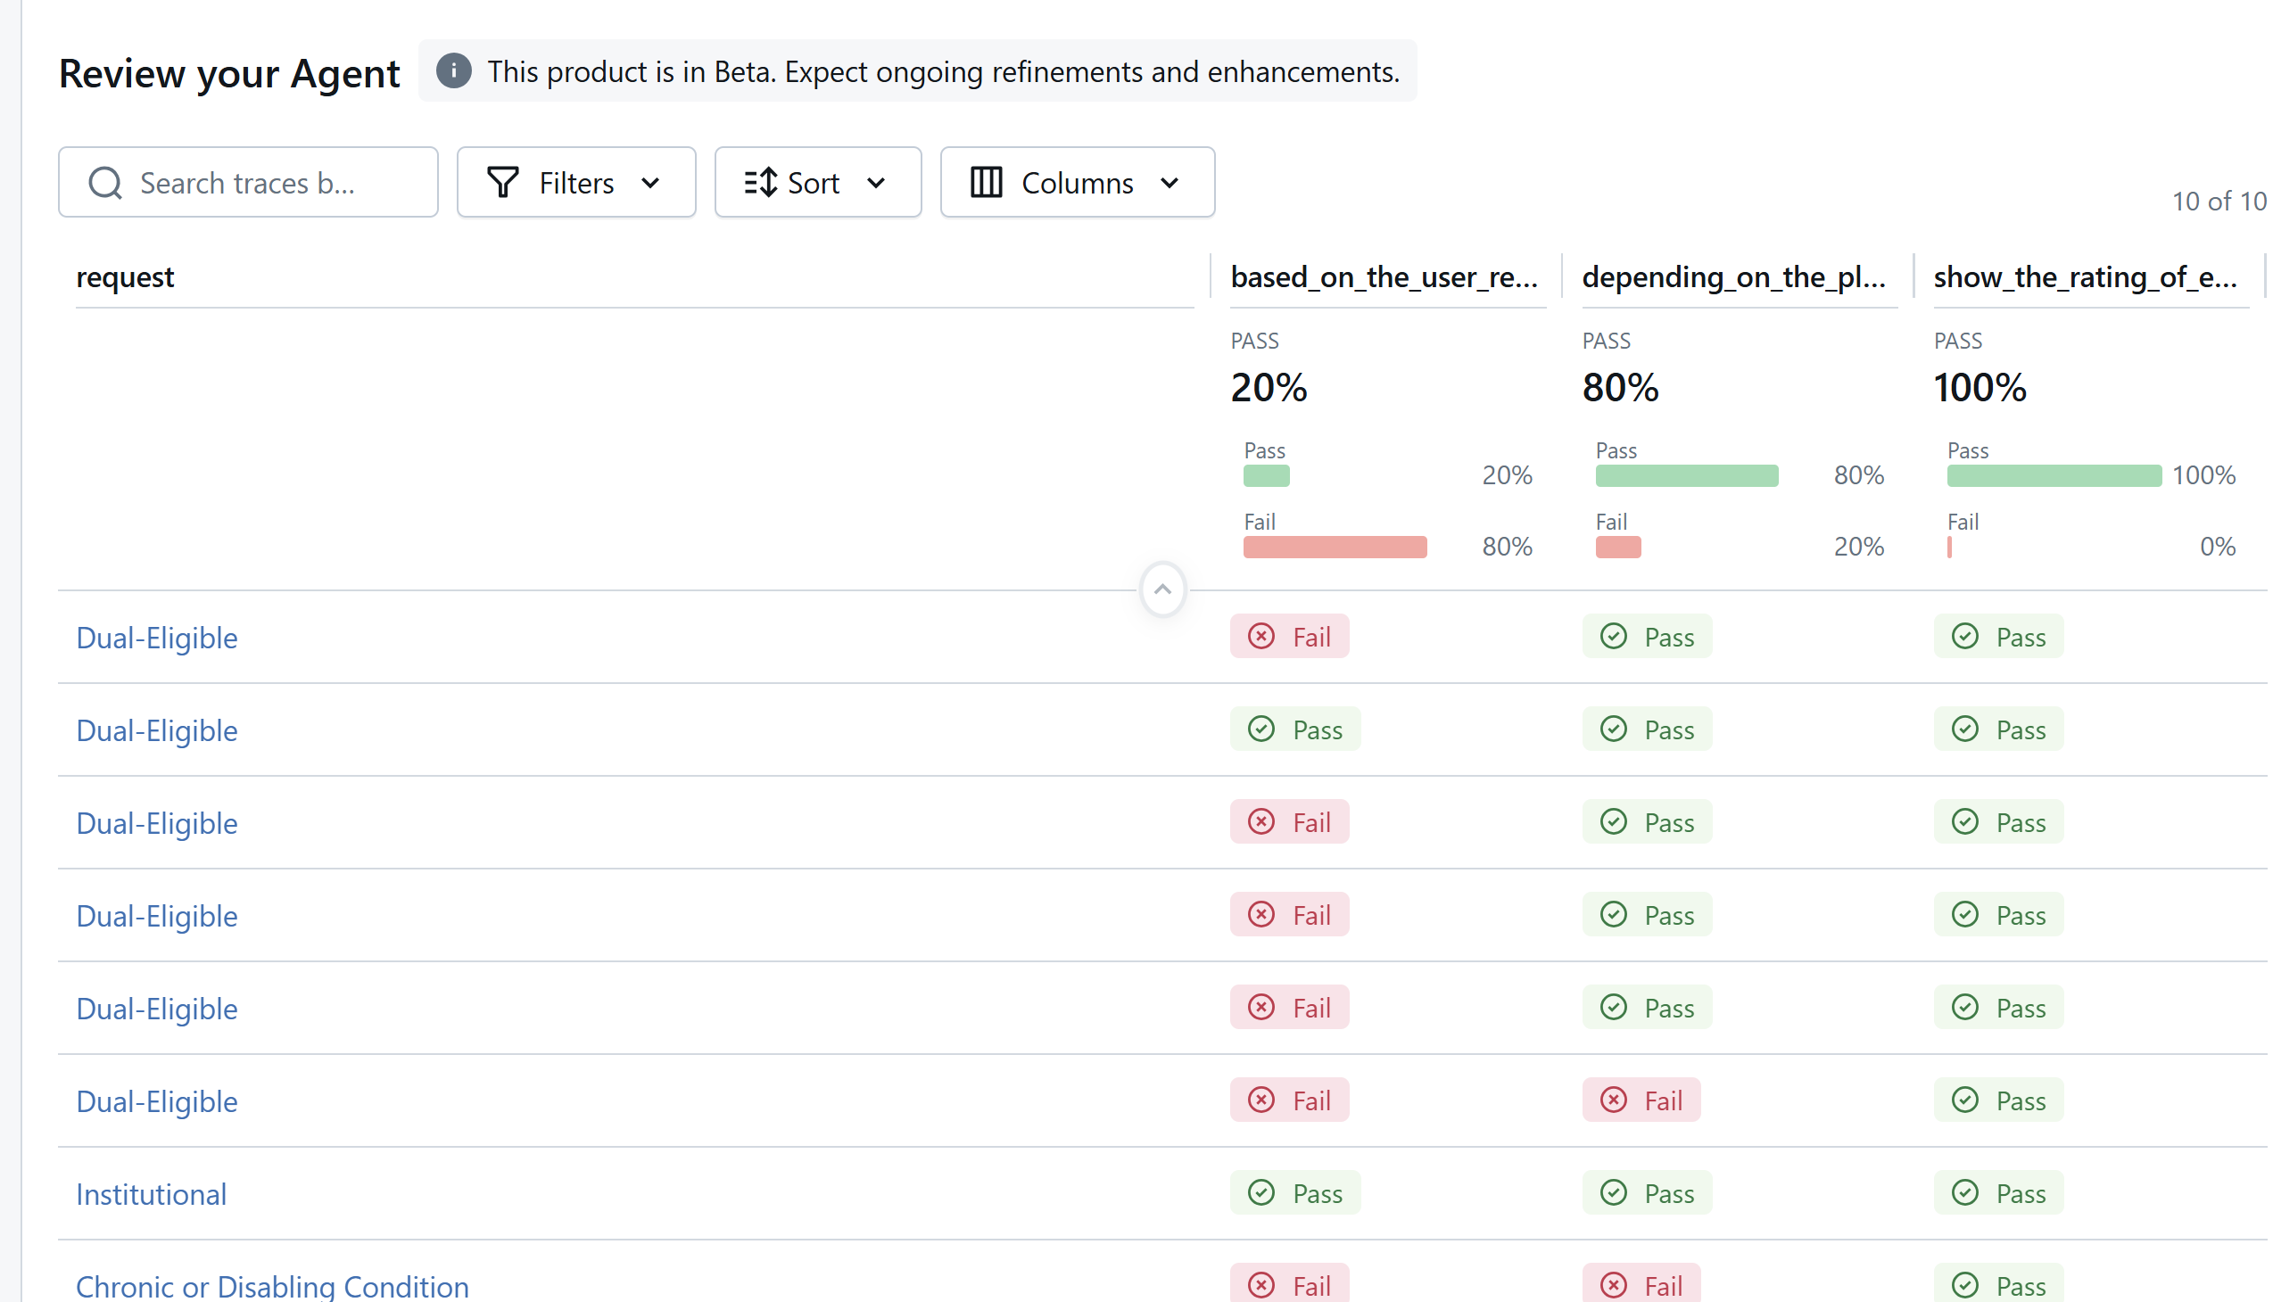




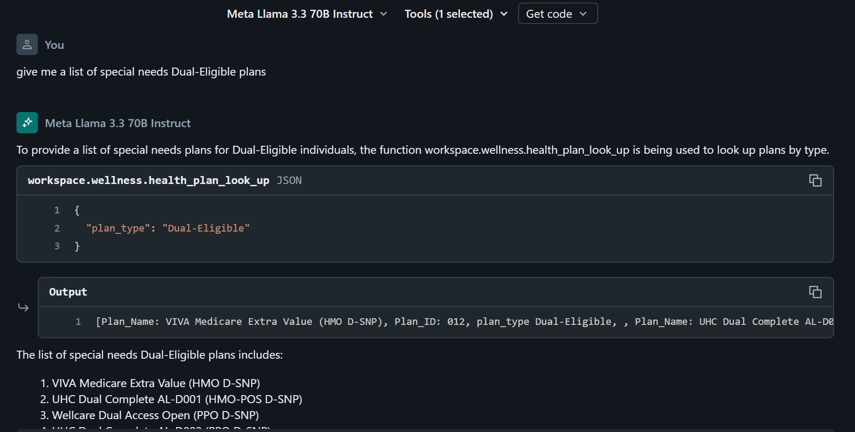
AI Agent Model
Llama 3.3
Functions
Test
Deploy

Slide 7
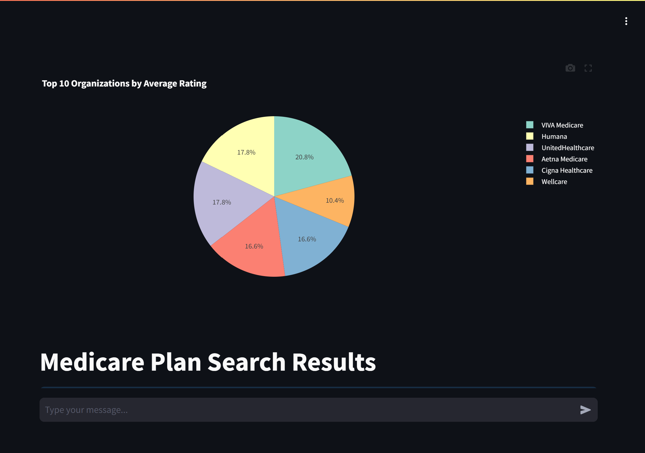
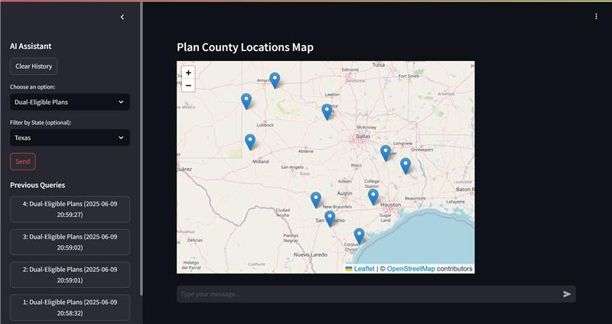
Serving platform
https://wellness-insights-2512194399771683.aws.databricksapps.com

Slide 8
NOW! We have more support for our Special needs communities !!!!
Accessible Information
Find the Right Coverage
Secure the Right PLan

Slide 9
Thank you
Github: https://github.com/Ricojacob01/databricks_hackathon_2025

